Slide 1

Major Project -II(CA401P) Even Semester Session 2025-26 “MuseCrafts” Ayush Saini (202410116100046) Ashish Yadav (202410116100041) Anubhav Vaish(202410116100037) Session:2025-2026 (IV Semester) Under the supervision of Mr. Roshan Kumar Gupta, Mrs. Anita Yadav Department Of Computer Applications KIET GROUP OF INSTITUTIONS, DELHI-NCR, GHAZIABAD-201206

Slide 2
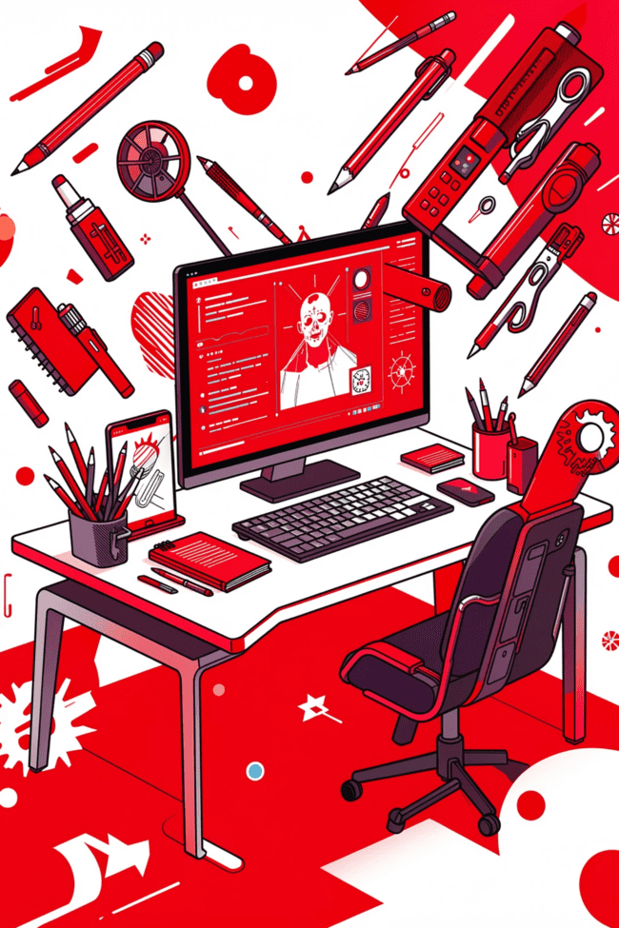
MuseCraft
Empowering Creativity Through Digital Innovation

Slide 3
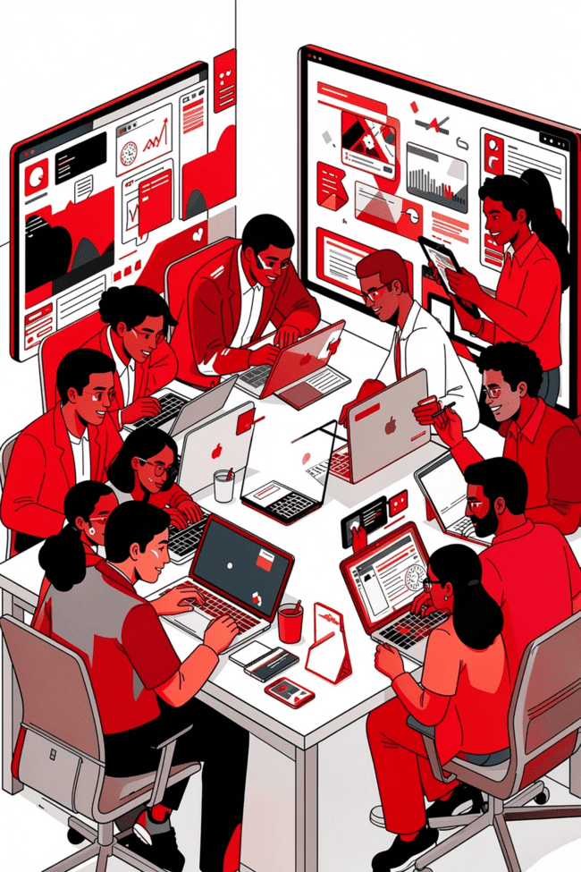
What is MuseCraft?
Creative Platform
Tech + Creativity
A digital platform designed for artists, designers, and content creators.
Combines technology with creativity to simplify content creation.
Inspiration
Focuses on innovation, collaboration, and inspiration.

Slide 4
Our Mission
01
02
Central Platform
Smart Tools
Provide a unified space for all creative work.
Enhance productivity using AI-based features.
03
04
Global Collaboration
Universal Support
Enable creators worldwide to work together.
Help beginners and professionals alike.

Slide 5
Key Features
Digital Content Creation
AI-Powered Assistance
Project Management
Comprehensive tools for generating creative content.
Smart design help powered by artificial intelligence.
Organize and track all your creative projects.
Portfolio Showcase
Team Collaboration
Share and publish your work online.
Work together on projects seamlessly.

Slide 6
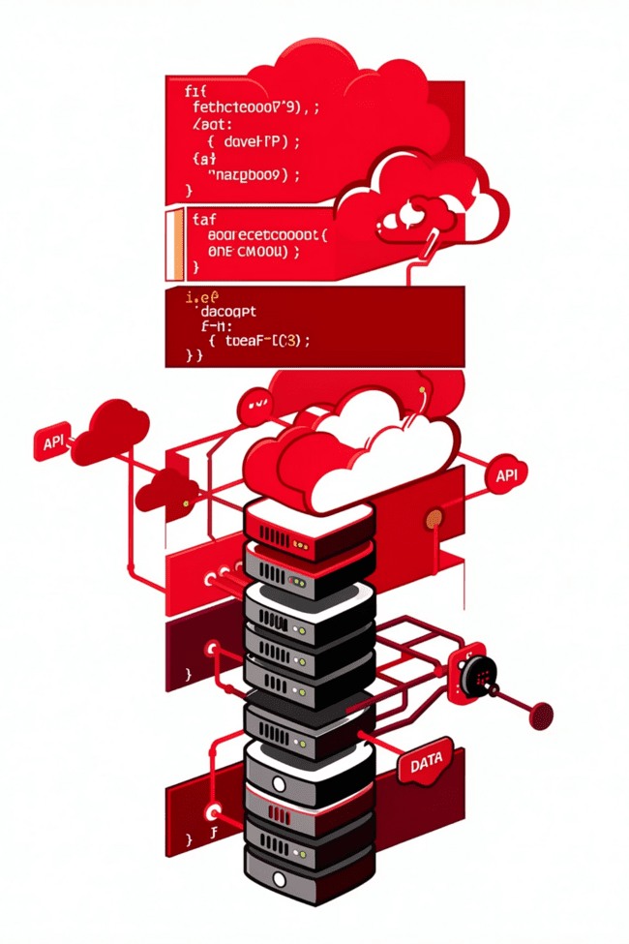
Technology Stack
Frontend
Database
React
MongoDB
Backend
Express.js
Node.js

Slide 7

How MuseCraft Works
Sign Up
User creates account and logs in.
Select Project
Choose type of creative project.
Create & Edit
Use built-in tools to develop content.
Save to Cloud
Store project securely online.
Share
Publish or share your content.

Slide 8
Why Choose MuseCraft?
Intuitive Interface
Time Savings
Creative Freedom
Easy-to-use design that works for everyone.
Automation features speed up your workflow.
Tools that encourage and enhance your creativity.
Anywhere Access
Team Support
Work from any device with internet connection.
Collaborate effectively with your team members.

Slide 9
Current Limitations
Internet Required
Premium Features
Needs stable internet connection to function.
Some advanced features may require payment.
Learning Curve
Performance
Beginners may need time to learn all features.
Depends on system specifications and speed.

Slide 10
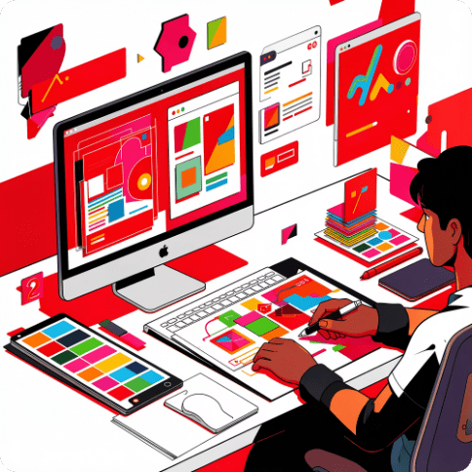
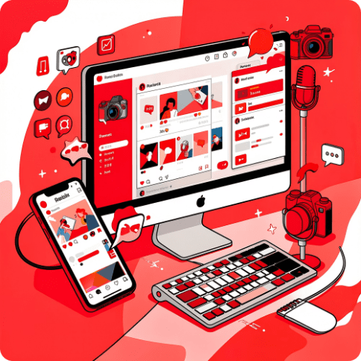
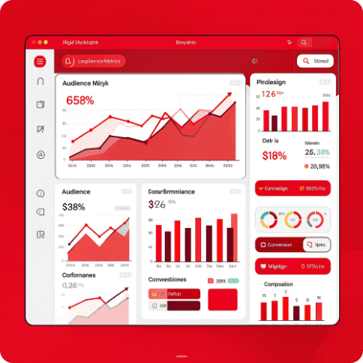
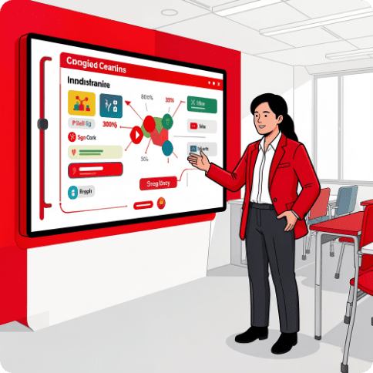
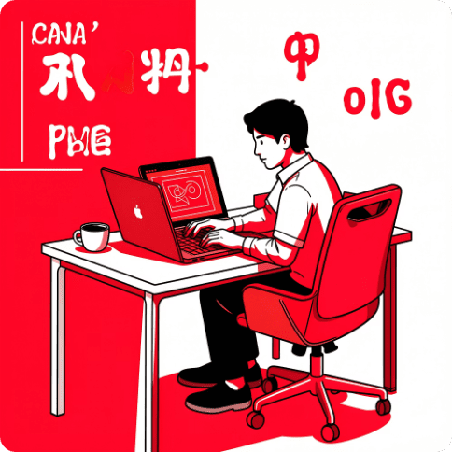
Applications
Graphic Design
Social Media
Digital Marketing
Education
Create stunning visual designs.
Generate engaging content.
Develop marketing materials.
Enhance presentations and teaching.
Freelancing
Manage client projects efficiently.

Slide 11
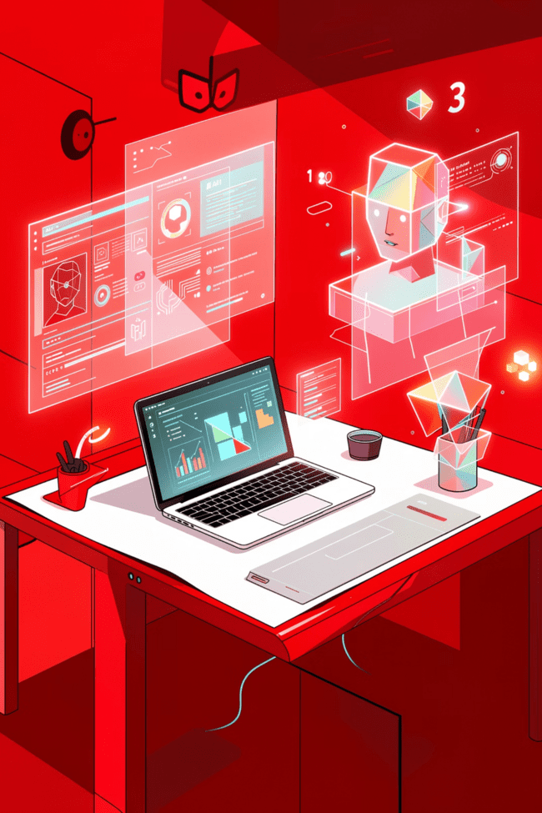
Looking Ahead
Powerful Solution
Universal Appeal
MuseCraft bridges technology and creativity effectively.
Useful for students, professionals, and businesses.
Future Growth
More advanced AI integration coming soon.

